Slide 1
Final Presentation : Research Internship Summary
-By Viraj Sharma
Under Prof. Wagatsuma
& Mentors Ahmad Altaweel, Seung Shin Lee
Notes:
Good morning everyone, and thank you for giving me the opportunity to present today
first of all i would like to extend sincere gratitude to Professor Shyam Pandey and Professor Wagatsuma for providing me with the opportunity to join this internship.
i am is also deeply thankful to my mentors, Ahmed-san and Lee-san, for their constant motivation and all the help they have given during the three-month internship. Their support has been incredibly valuable.

Slide 2
Internship Overview
This internship was conducted at the prestigious Kyushu Institute of Technology in Japan, offering a unique opportunity to dive deep into the field of autonomous driving simulation.
The internship’s primary goal was to understand the core Functionality and working of the Autonomous Vehicle.
I was part of a team that was guided by experienced faculty members, including Professor Wagatsuma , our mentors Ahmad Altaweel and Seungshin lee.
In the first two weeks, we were first introduced to foundational algorithms such as Depth First Search (DFS), Breadth First Search (BFS), cost minimum search, best-first search, and dynamic programming.

Slide 3
The professor provided us with three Jupyter notebooks: osm_reader, osm_simulator, and point_cloud_reader. I chose the osm_simulator due to my personal interest in traffic systems and the complexity involved in simulating real-life vehicle movement.
Over the next week, I dedicated myself to thoroughly studying the code in the osm_simulator jupyter notebook.
But first I had to learn about basic data structures used in autonomous car driving simulation. Such as:
Nodes (<node>)
Represents points with latitude and longitude.
Used for landmarks, POIs, and road junctions.
Ways (<way>)
An ordered list of nodes, forming lines or polygons.
Represents roads, rivers, boundaries, or building footprints.
Relations (<relation>)
Groups multiple elements (nodes, ways) into complex structures.
Examples:
Bus routes
Turn restrictions
Traffic signals coordination
Tags (<tag>)
Metadata defining properties of an element.
Example tags:
highway=motorway → Major highway.
oneway=yes → One-way road.
maxspeed=50 → Speed limit 50 km/h.
Notes:
bata 3 jupyter notebooks mili thi

Slide 4
5. LineStrings(<lineString>):A LineString is a set of connected nodes forming a continuous line, used for lane boundaries and regulatory signs.
6. Lanelets:A Lanelet is the smallest drivable lane unit in autonomous driving maps.
Each Lanelet is defined by a left and right boundary (LineStrings).
Can store attributes like speed limits, traffic rules, and direction.
The next focus was on understanding :
Data Parsing:How to parse OSM Data i.e how to extract nodes, ways, and relations from Openstreetmap files.
Coordinate Transformation: How to transform coordinates from global EPSG:4326 to Japan-specific EPSG:6678 for accurate plotting
Visualization: How to create road network visualizations using Matplotlib.
Basic Vehicle Movement: how to implement initial vehicle movement along hardcoded paths
After that the main focus was on understanding how the vehicles moved in predefined paths.
This provided valuable insights into the limitations and strengths of the given codebase, especially its handling of intersection dynamics.
Notes:
hum ne samgha kya us notebook main+ parse kari pehle phir transform kare cordinates and uske baad vehicle movement hui

Slide 5
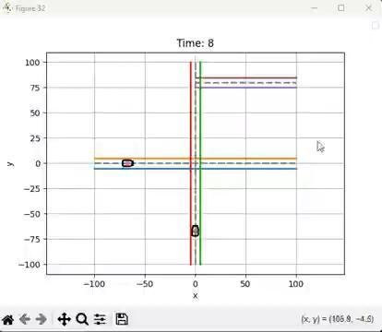
Identifying the Problem – Collision at Intersections
One major issue I identified was that vehicles in the simulation were passing through each other at intersections. But, In the real world, such behavior would result in accidents.
The original simulator lacked proper collision detection and avoidance logic at intersection zones.
Notes:
bata kya problem thi

Slide 6
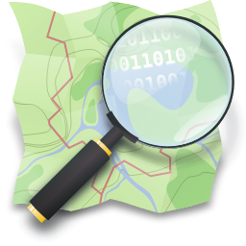
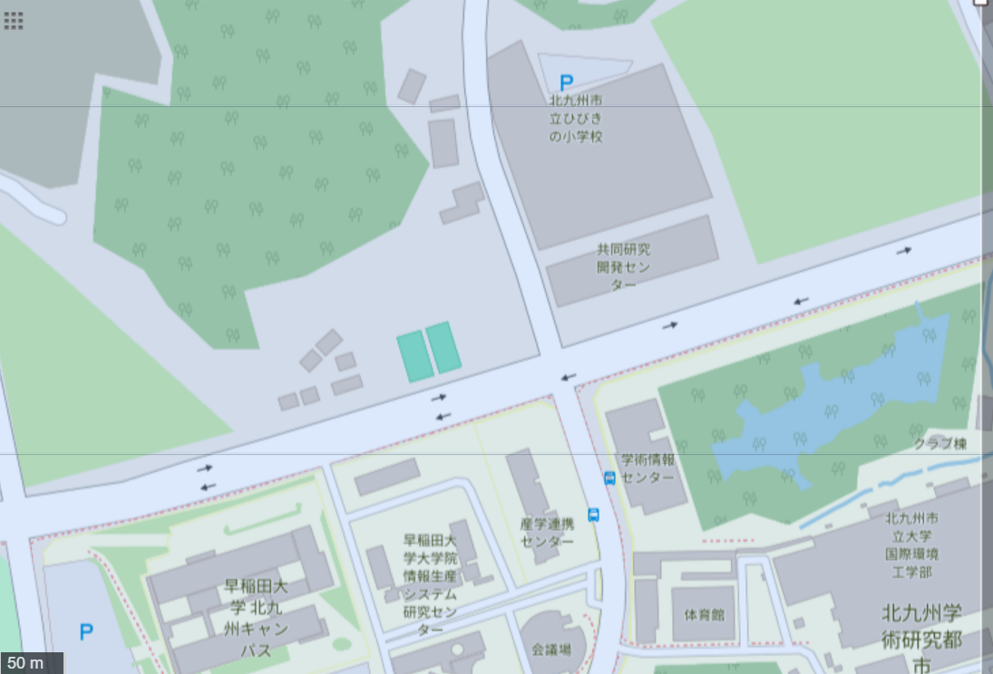
Understanding this limitation sparked the need to add collision detection and avoidance logic in the code. So our objective became clear simulate more realistic vehicle behavior at intersections so that they do not pass through each other leading to collision.
To address this, I began by exploring the OSM data and how we can get our own OSM data for the intersection.
The first option was to get the data from OpenstreetMap website.OpenStreetMap database is a community-driven, open-source mapping platform that provides global geographic data. It serves as a base map for various applications, including navigation, GIS (Geographic Information Systems), and urban planning.So I found an intersection just near the University campus and downloaded its osm data.
And the second option was to create our own data. So i decided to go with the first option.
However, I found that the data from OpenStreetMap database was often incomplete—most notably, relations (which define turn restrictions and complex intersections) were missing or not properly formed. This hindered our ability to rely on online OSM data alone.
Notes:
so hum add karna pada collision detection and avoidance, Openstreet Map website or own data , osm website data was incomplete

Slide 7
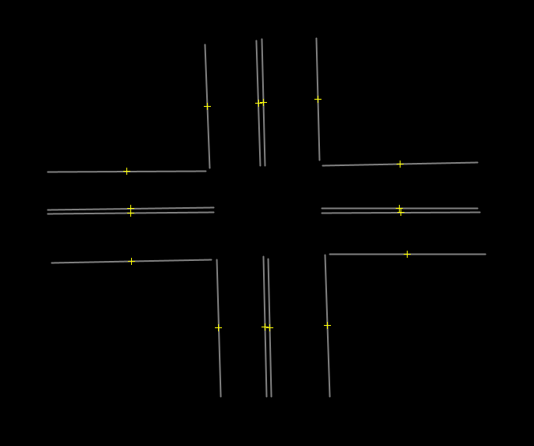
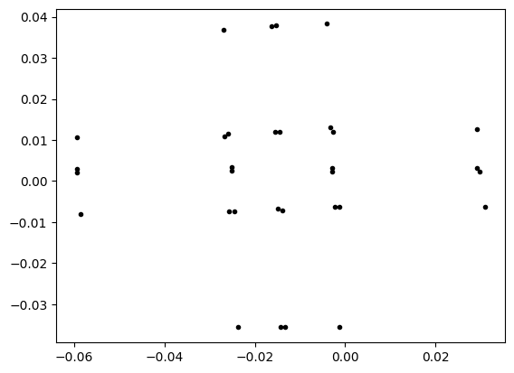
Consequently, we had to rely on the other option which was to manually design a custom intersection using JOSM (Java OSM Editor) and export it with Lanelet2 preset enabled which was suggested to us by Obada-san.
Lanelet2 is a popular map format for autonomous driving used with ROS (Robot Operating System) and allows for rich semantic labeling of lanes, traffic rules, and turn directions. However, installing Lanelet2 required a transition to Ubuntu Linux and a full ROS setup.
Obada-san also provided us with a video of a previous lab member Mr. Arvind Srivastav which showed how to use JOSM with lanelet2 preset to create lanelets.
Rebuilding the Intersection Using Lanelet2
To overcome the limitations of incomplete OSM data, we decided to manually construct an intersection map using JOSM, leveraging the Lanelet2 preset for semantic accuracy.
Setting this up was a significant technical step. First, I installed Ubuntu and configured ROS (Robot Operating System), which is essential for compiling and working with Lanelet2.
After successfully setting up the environment, I used JOSM to draw roads and intersections, define traffic flow directions, and export the map in a Lanelet2-compatible format.
Notes:
josm + lanelet2

Slide 8
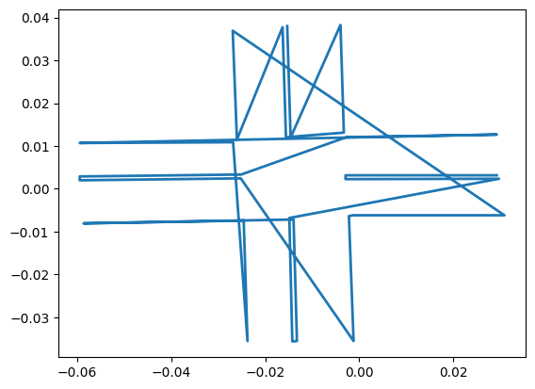
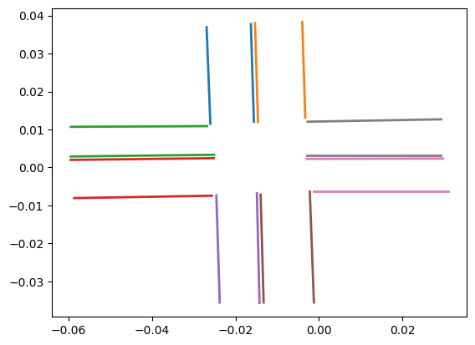
Unfortunately, due to time constraints and the steep learning curve of ROS, I could not fully integrate dynamic vehicle movement within the Lanelet2 map. Instead, I shifted my focus to the core objective: how to avoid collisions between two vehicles at an intersection, using simulation and mathematical modeling.
Despite this pivot, building the Lanelet2 map was a valuable experience. It showed the importance of accurate digital maps for autonomous navigation and highlighted the complexity involved in even seemingly simple tasks like creating an intersection.
Notes:
kar nahi paye hum dynamic vehicle movement within lanelet2

Slide 9
Simulation Setup – Continuous State Vehicle Models
The next phase was to model vehicle motion using continuous state variables—this includes position (x, y), orientation (theta), and velocity (v).
I designed a custom Vehicle class in Python, which models a car with parameters for position, velocity, dimensions (length and width), and its navigation path. Each vehicle could follow a series of waypoints with real-time updates to its position and heading using trigonometric calculations.
The simulation has one vehicle coming from the north direction and the other one coming from the west direction
I also added a rule system, where each vehicle had a state variable (0: Go, 1: Yield). This would later be controlled dynamically using three different models for collision detection: deterministic logic, Time-to-Collision (TTC), and Continuous-Time Markov Models (CTMM).
This setup allowed for testing multiple collision scenarios by altering vehicle speeds and start times. It became a robust base for running experiments on intersection behavior, path planning, and avoidance strategies.

Slide 10


Collision Avoidance Strategies – Deterministic, TTC, and CTMM
1.Deterministic Model:
How It Works:
The deterministic model is based on kinematics: position, speed, and time. it has three components:
1. Vehicle State Parameters:
Each vehicle is described using:
x, y: Current position
v: Speed (constant)
angle: Direction of travel (assumed fixed for simplicity)
target: Position of the center of the intersection
2. Time to Reach Intersection:
This formula assumes constant velocity and straight-line motion toward the center.
3. Collision Criteria

Slide 11
We declare a potential collision if the difference in time for both vehicles to reach the intersection is less than a collision threshold, say 1.0 seconds:
Based on this evaluation, the model statically decides which vehicle should yield (stop) and which one should go, using pre-defined rules (e.g., vehicle on the right has priority, or the one farther from the intersection yields).
So the next question is Is the Threshold Arbitrary or Random?
No — it's not random. While in code it may seem like we’re just assigning a value like 1.0 second to the threshold, but this value should ideally be based on real-world traffic dynamics, vehicle behavior, and safety margins.
How is the Threshold Time Determined?
The value of threshold is determined by:
1. Vehicle Length and Speed:
Let’s say a typical vehicle is ~ 4.5 meters long. At 10 m/s (36 km/h), a car covers:
Distance Covered = 10 m/s × 1 sec = 10 meters
So if two cars are predicted to arrive at the same intersection point within 1 second, they could be within a collision distance of 10 meters, which is dangerously close.
2. Human Reaction Time:
A typical human reaction time is about 0.7 to 1.5 seconds. Even in autonomous systems, sensors and controllers have a delay (called actuation delay). So a threshold like 1 second provides a buffer for:

Slide 12

Detecting the other vehicle
Deciding whether to brake or proceed
Acting (braking or steering)
3. Stopping Distance:
Stopping distance depends on the speed and deceleration. If your car decelerates at 5 m/s² from 10 m/s:
So, if your vehicle needs 10 meters to stop safely, then you need to detect potential collisions at least 1 second in advance (assuming constant speed). So again, 1 second threshold aligns with realistic safety margins.

Slide 13
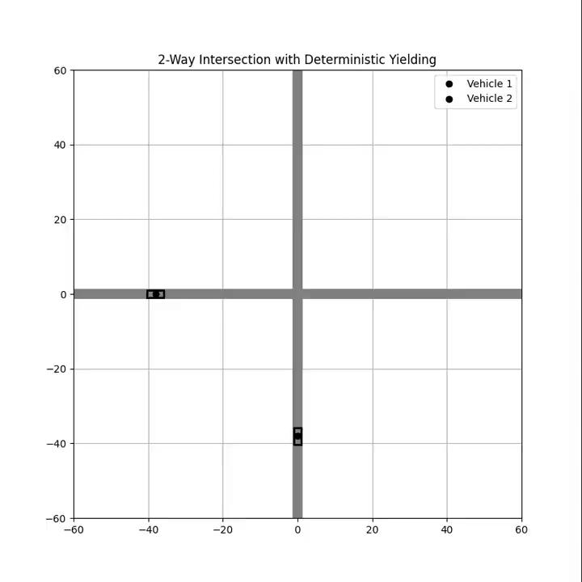
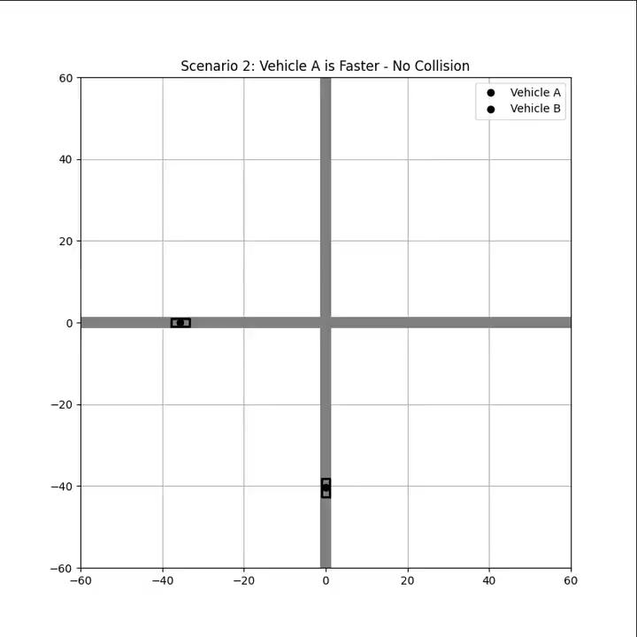
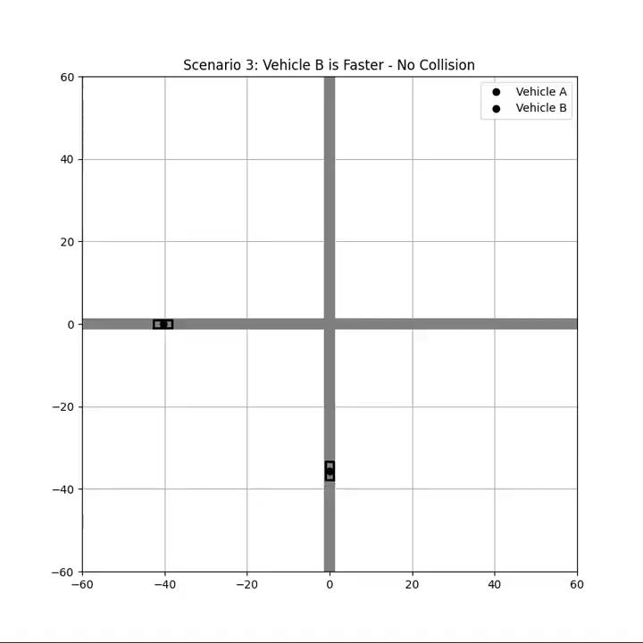
With Ahmad-san’s suggestion I tested three basic scenarios in this avoidance logic
First, both vehicles have equal speed and distance to the intersection – collision is inevitable.
Second, vehicle A is faster – it passes before Vehicle B arrives, so no collision.
Third, vehicle B is faster – it crosses before Vehicle A, so again no collision.
Scenario 1: Equal speed
Scenario 2: Vehicle A is Faster
Scenario 3: Vehicle B is Faster

Slide 14


2. Time-To-Collision (TTC) Model
How It Works:
TTC is a predictive measure used to estimate how soon two moving objects will collide if they continue at their current velocities.
Implementation:
Function Definition:
vehicle_a, vehicle_b: two vehicles involved in a potential collision.
dt: time step (used for consistency in simulation).
ttc_threshold: the time within which a collision is considered "dangerous" (e.g., 2.5 seconds).
min_distance: if after that time, the vehicles are closer than this, it’s a risk (e.g., 4 meters).
2. Get Positions
These are the current (x, y) coordinates of both vehicles.
3. Get Velocity Vectors:
get_velocity_vector() returns the current velocity as a 2D vector (vx, vy) — i.e., direction and speed.

Slide 15


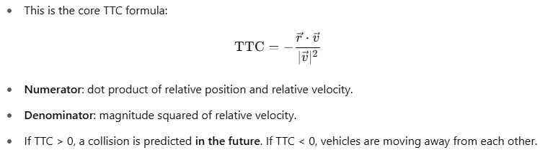
4. Get Relative Position and Velocity:
rel_pos: relative position of vehicle A with respect to B. rel_vel: relative velocity of A with respect to B. We now assess how A is moving relative to B, which is essential for TTC computation.
5. Handle nearly zero relative speed:
If both vehicles are moving at nearly the same speed and direction, relative speed is almost zero.
TTC becomes undefined or infinite, so we simply skip any avoidance logic here.
6. Compute Time to Collision:

Slide 16

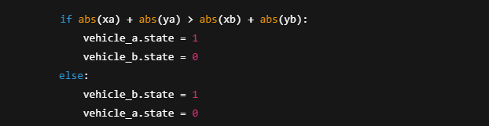
7. Compute Time to Collision:
We predict the future position of both vehicles after ttc seconds and check their distance at that point.
This helps determine how close they will be at the time of predicted collision.
8. Filter out false alarms:
Collision is only a concern if:
TTC is positive.
TTC is below a threshold (i.e., less than 2.5 seconds away).
And they will be within min_distance at that point (e.g., closer than 4 meters).
This filters out false alarms from distant or slow threats.
9. Resolve collision with priority logic:

Slide 17
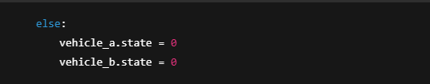
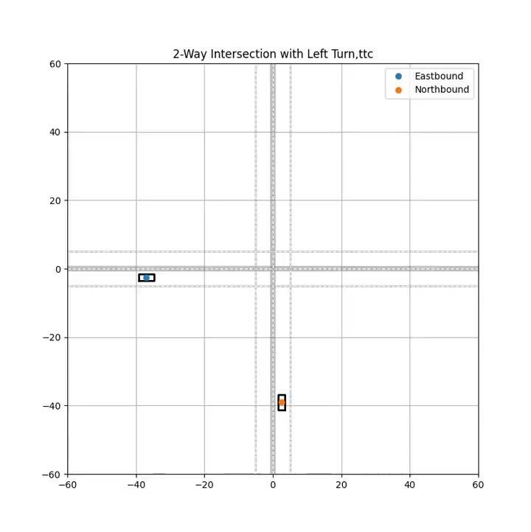
The vehicle that is closer to the intersection center (0, 0) is given priority.
It is determined by checking whose abs(x) + abs(y) is smaller (closer to the center).
9. Reset if threat has passed:
If no immediate threat is detected (TTC too large or distance is safe), both vehicles are reset to "GO" mode.

Slide 18
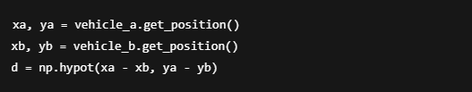
3. Continuous-Time Markov Model (CTMM)
How It Works:
CTMM is a stochastic (probabilistic) model that simulates state transitions over time.
Each vehicle is treated as a two-state system:
State 0: Go
State 1: Yield
The transition between these states happens with certain probabilities per time unit:
From Go to Yield: r_01 = α * exp(-d / β)
From Yield to Go: r_10 = γ * (d / δ)
Here d is the distance between vehicles, and α, β, γ, δ are tuning parameters.
These rates define how likely a vehicle is to decide to stop or go, mimicking real driver behavior or uncertainty in AI decision-making.
Implementation:
1. Get Positions and Distance:
This fetches the current (x, y) positions of both vehicles.
d is the Euclidean distance between the vehicles — this tells us how close they are to each other.
This distance d is key to determining how likely they are to collide and whether a safety rule should kick in.

Slide 19
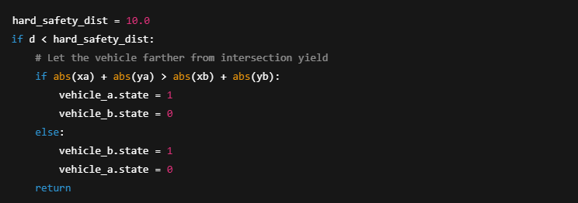

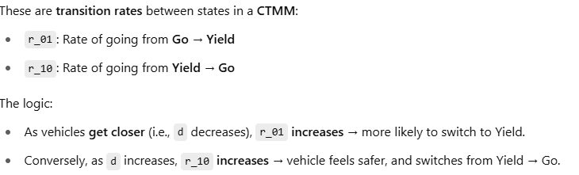
2. Hard Safety Rule — Deterministic Avoidance:
We are also implementing deterministic safety mechanism:
If vehicles are closer than 10 meters, we assume there's high collision risk.
and we don’t rely on probabilities here and make a definite decision to prevent collision.
How is the decision made?
The vehicle that is closer to the center of the intersection (i.e., whose abs(x) + abs(y) is smaller) is allowed to go.
The vehicle farther is told to yield.
3. Probabilistic CTMM-Based Avoidance

Slide 20
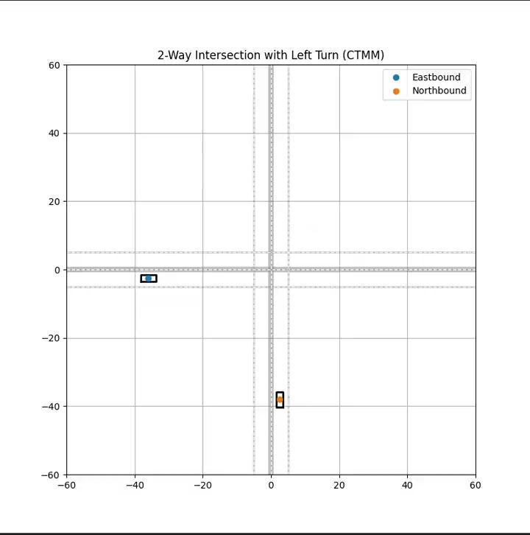

Slide 21
Comparison Table:
Challenges faced:
Incomplete OSM Data: One of the first issues I faced was with the raw OpenStreetMap (OSM) data downloaded from the official site.While the OSM XML file provided detailed nodes and ways, the relation tags were either missing or inconsistent, which made accurate lanelet generation very difficult.
Model | Nature | Realism | Complexity
Deterministic | Rule-Based | Low | Low
TTC | Analytical | Medium | Medium
CTMM | Probabilistic | High | High

Slide 22
Switch to JOSM + Lanelet2: Due to the incomplete OSM data, we had to completely change the map creation pipeline, moving to JOSM (Java OpenStreetMap Editor) and Lanelet2, which required learning a new GUI-based tool (JOSM) to manually draw and tag elements.
Ubuntu and ROS Setup: Since Lanelet2 is tightly coupled with the Robot Operating System (ROS), I had to install Ubuntu, configure ROS, and then clone and build the Lanelet2 repositories.]
CTMM Mathematical Complexity: The Continuous-Time Markov Model (CTMM) was conceptually and mathematically intensive, I had to understand stochastic state transitions, Markov properties, rate matrices etc.
Time Constraints and Trade-offs: Due to the limited timeframe of the internship, I couldn’t implement fully dynamic vehicle motion using Lanelet or path-following algorithms. Instead, I focused on accurate logic for collision detection and avoidance, using a simplified static or constant-speed model.This trade-off was crucial for completing the project goals.
Learnings:
Working with Real-World Map Data: I learned how to parse OSM XML data to extract meaningful structures like nodes, ways, and relations which can be used to convert map data into a simulation-ready format.
I became proficient in manual map creation using JOSM and applying Lanelet2 tagging standards.
I learned how to make python animations using matplotlib, FuncAnimation, and numpy.
Earlier in the internship, we were taught foundational algorithms like DFS, BFS, and best-first search etc, these helped conceptualize graph traversal, shortest path computation, and how autonomous agents could navigate through a graph-represented environment.

Slide 23
Conclusion:
Deterministic model:
It’s the baseline model. Easy to implement and interpret.
Good to verify the working of your simulation before adding complexity.
Helps validate basic physics and logic in intersection handling.
TTC Model:
Provides a middle-ground between hardcoded deterministic logic and soft probabilistic models.
Allows simulation to respond to real-time changes.
Helps transition your model toward real-world behavior and variability.
CTMM Model:
Helps simulate soft behaviors like hesitation, over-cautiousness, or over-aggressiveness in self-driving agents.
Adds randomness and variability, useful for large-scale simulations or reinforcement learning training environments.
By tuning the rates, you can study how cooperative or selfish AVs would behave at intersections.
Future Work:
Create Vehicle movement using the actual lanelet2 data.
Add more vehicles in the simulation for more complex intersection scenarios and group dynamics.
Add traffic lights, stop signs, and pedestrian rules to increase realism.

Slide 24
Thank You!
ありがとうございます!
धन्यवाद!

